Slide 1
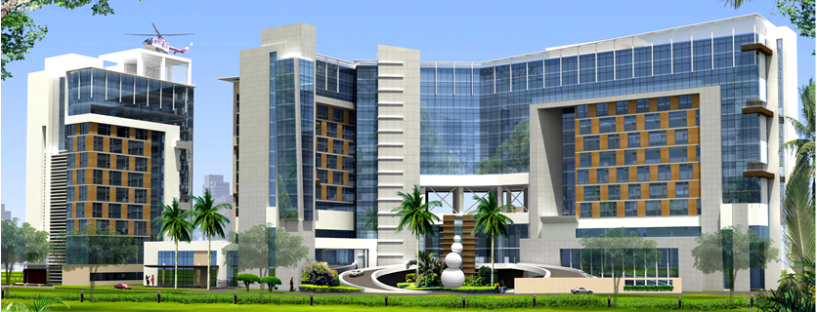


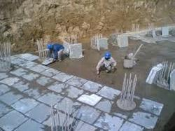

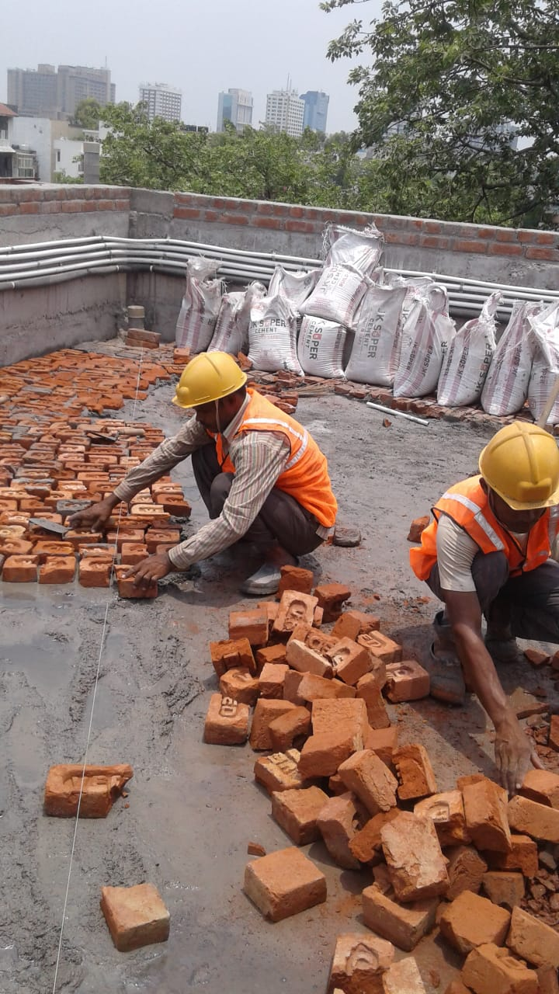

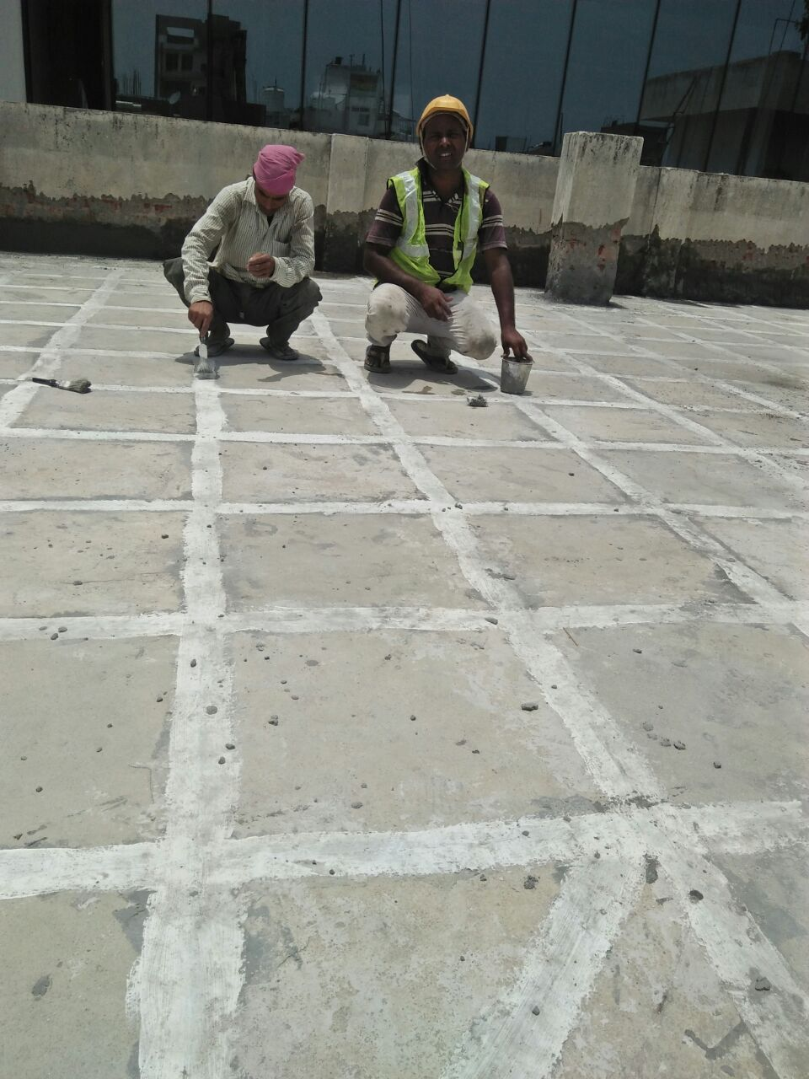

Superlative
uperlative
S
y
S
s
S
tructure
S
t
e
W
m
aterproofing
s
WE
Superlative Structure Waterproofing Systems
Regd. Office
Unit No.-276, Dreamland Apartments, DDA Expandable
Housing, Pocket No.10, Sec-1-A, Nasirpur, Dwarka, New Delhi-
110045, Tel:011-25394811, Mb. 9266638111-2-3,
Email<sswps2015@gamil.com>
Godown / Br. Office
566/403, Street No.-15-D, Shivpuri, Sagarpur West, New Delhi,
PIN- 110046, Tel : 011-25398035, Mb. : +91-9873622056,
9810187547, 9810579084, <Email<rkssscw@gmail.com>
BANKERS
State Bank of India, HDFC Bank, Central Bank of India
FIRM Registration No.
Applied for
PAN No. GST No.
ACWFS4159G 07ACWFS4159G1ZI
EPF No. ESIC No.
DLCPM1392913000 20001220370000900
Co. Profile Contd.

Slide 2
Forewords
We would like to introduce “Superlative Structure Waterproofing Systems” as an Especialized Water proofing Agency active in the field of especialised WATER PROOFING services in the Segment of Commercial, Industrial & Residential Buildings for the "Waterproofing Services" into all "Water-Prone Areas" as under –
* Basement, Toilets, Kitchens, Sanitary-Shaft, Terraces, Balconies, Chajjas, RCC Water Tanks.
* Terrace-gardens, Planter Boxes, Swimming Pools, Balancing Tanks, Fountain, Water-Falls.
* Tunnels, Machine-Pits, Cable-Pits, Drains, RCC Gutters, AHU, u/g ESS, Pump-Rooms, STP-Tanks eeeETP Tanks, Utility Areas, Oil-Tank, Septic Tank, Wet Processing Areas, Washing Areas.
Superlative Structure Waterproofing Systems for our Waterproofing Services applied in above areas we used very easily available building materials i.e. Cement, Coarse Sand, Brick Bats, Rough Kotah Stone, Rough Agra Stone, 12mm downsize Stone Aggregate etc. with 22 years Prospective, Plasticized & Mercantiled team who performs as –
* Especialized Cement Based Waterproofing Systems
* Cheap & Best as well as Time Tested of 20 Years
* Worked With all Business-Categories of Clients
* Worked as Qualitative & Quantitative
* Worked as Dynamic & Consistant
* Continuing Skilled Team since 23 years
* Job Expanded itself thru Ever Past clients
Superlative Structure Waterproofing Systems concern lead by a 33 years experienced Civil Engineer expaned his services in Northern India not less than Delhi-NCR, Haryana, Panjab, Rajasthan, U.P., M.P., Jammu, Sikkim, Assam, Kerla, Andhra Pradesh, Telangana.
Superlative Structure Waterproofing Systems commitment to Ethical standards, Service Gratitude, Defect Free Quality, Systems Upgrading, Cost-Optimazation, Trust, Shedule-Adherence, meet Customer Expectations, Deliver in Safer, faster & simply Better, Long Term Healthy & Strong Relationship and Post Execution Services is well appreciated by its honorable clients to whom its has served as List of Executed works in the Annexxure attached herewith in 18 Pages.
Superlative Structure Waterproofing Systems being technically competent and resourceful, capable foe immediate mobilizing for all quantum of Jobs in all kinds of Hospitality, Industrial, Institutional, Hospital, Residential & Commercial Building.
Co. Profile Contd.

Slide 3
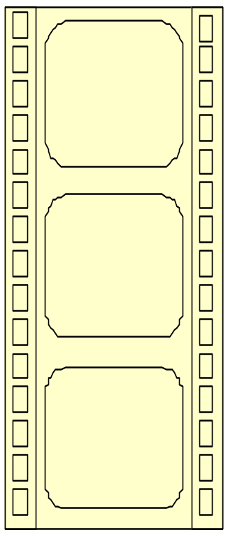
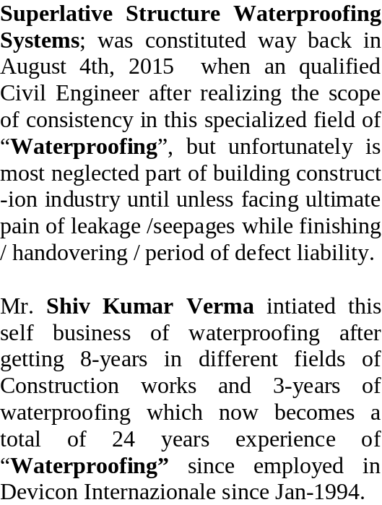
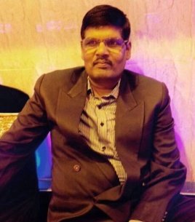
Constitution / Story
Diploma
CIVIL ENGG
from
Lucknow
1985-I-Class
Jainsons Prop.
Farm House Development
Ghitorni
New Delhi
J. E. Civil
Trainee
NH-29,
UP-PWD
“Devicon W/p Div.” a Grp. of Ex. “Overseas Waterproofing
Corporation”
J. K. Constn,
Dam Project
U.P., under
Central Water
Commission
(Self Prop.)
“CWC”
Consistant
Waterproofing
Co.
Qualification : Diploma Civil Engg :
PY-1985, Ist Class
Lucknow Polytechnic
Lucknow-5.
Experience : Waterproofing / 24 Yrs
Construction / 08 Yrs
Years
Age : 51 Years
Taking Care of : Business-
Promotion,
Tendering,
Planning,
Execution, Finance,
Accounts.
Sarswati Builders,
Ind. / School
Buildings
under EIL
(Self Director)
“SSSSPL”
SS Seepage
Solutions Pvt. Ltd.
Hukumchand Associates, Farm House Development, Palam Vihar.
(Self Director)
“SSWPL” Satyam Shivam
Waterseal Private Ltd.
V K Interiors, Lajpat Nagar, Kothi, Office,
Interiors
Works
(Since 2015) Superlative
Structure
Waterproofing
Systems
Co. Profile Contd.

Slide 4
Organization
With the experience, qualification and sincere, professional and right kind of altitude “Superlative Structure Water -proofing Systems” has formed an inhouse team of skilled foremans, supervisors and workers to execute the job as per clients shedule as below –
MR. SHIV KUMAR VERMA
Executive Partner, Project,
Finance & Taxation
Mrs. Sheela Verma, Managing
Partner (Purchase, Petty
Cash & Housekeeping)
Mr. Surender Singh Yadav,
All Disputes in Projects,
Finance and Clients
Mr. Rajiv Kumar Verma,
Admn & Finance &
Housekeeping
Mr. Nand Kishore
Verma, Transport,
& Project
Mr. Nurul Ahmad,
Pre-Contract Observation
(Job), Operation &
Complaint
Mr. Nurul Ahmad,
Pre-Contract Observation
(Job), Operation &
Complaint
Md. Allimuddin,
Foreman
Akhtar Alam,
Foreman
Md. Anjar,
Foreman
Md. Nazir,
Foreman
Md. Afsar Alam,
Foreman
Shamim Akhtar,
Foreman
Abbas Alam
Shafik Alam
Co. Profile Contd.

Slide 5
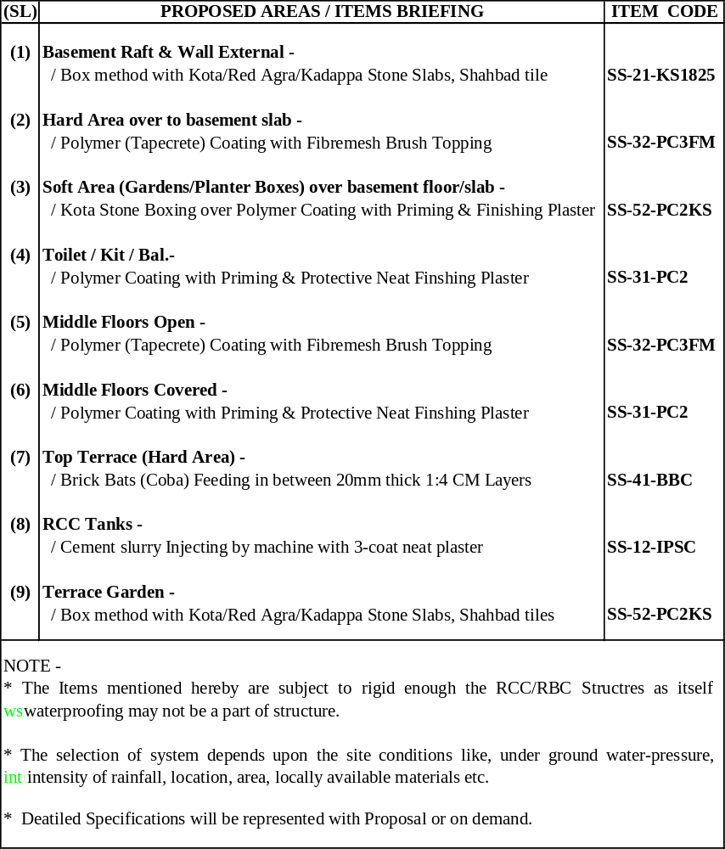
SPECIFICATION DESIGNED FOR SITUATIONAL REQUIREMENT
Co. Profile Contd.

Slide 6
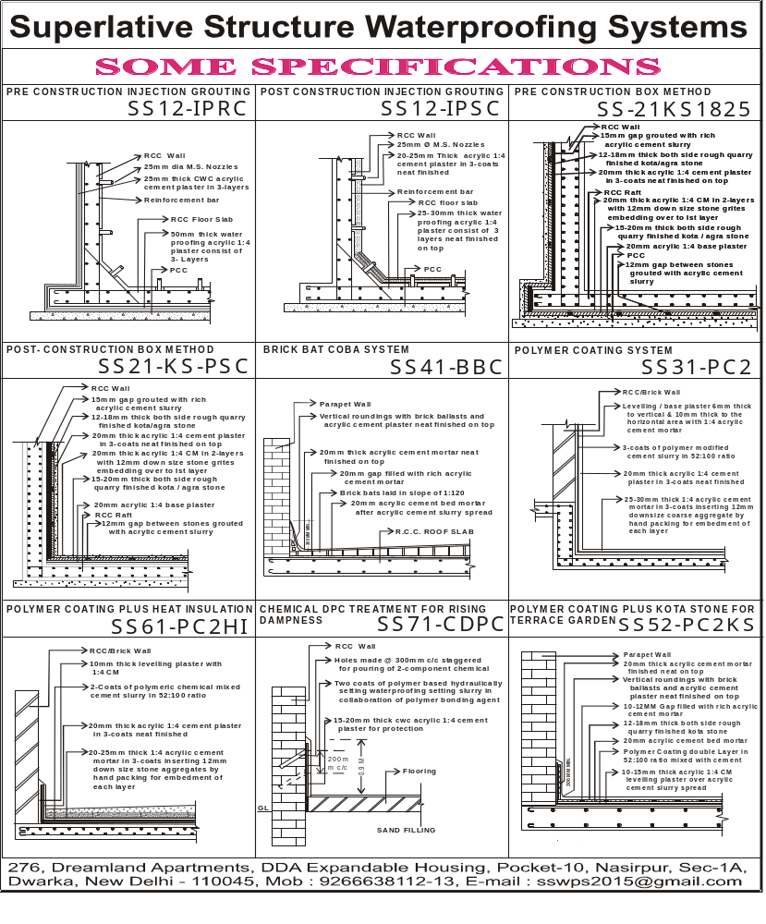
Co. Profile Contd.

Slide 7
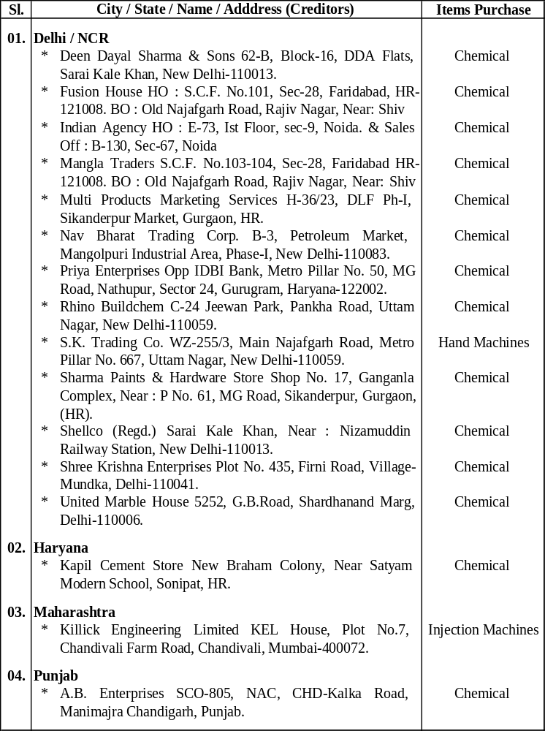
Associates for Supplying of Chemicals & Tools
Co. Profile Contd.

Slide 8
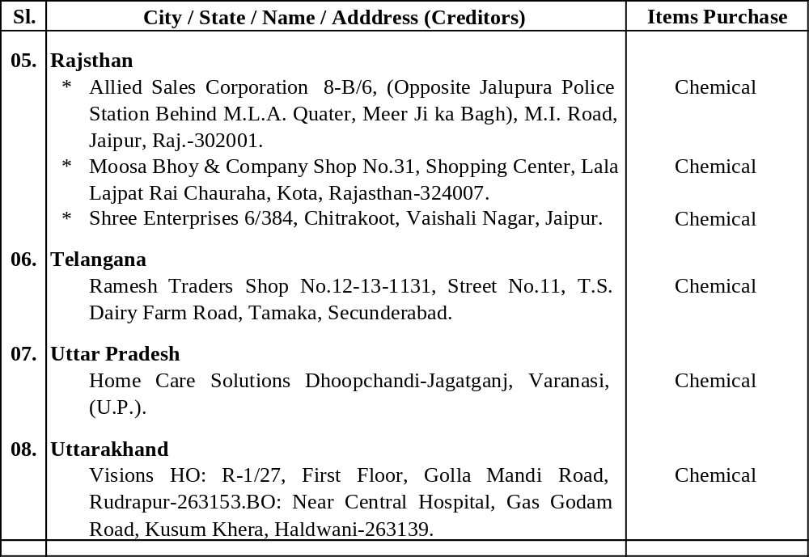
Contd. List of Associates / Suppliers
Co. Profile Contd.

Slide 9
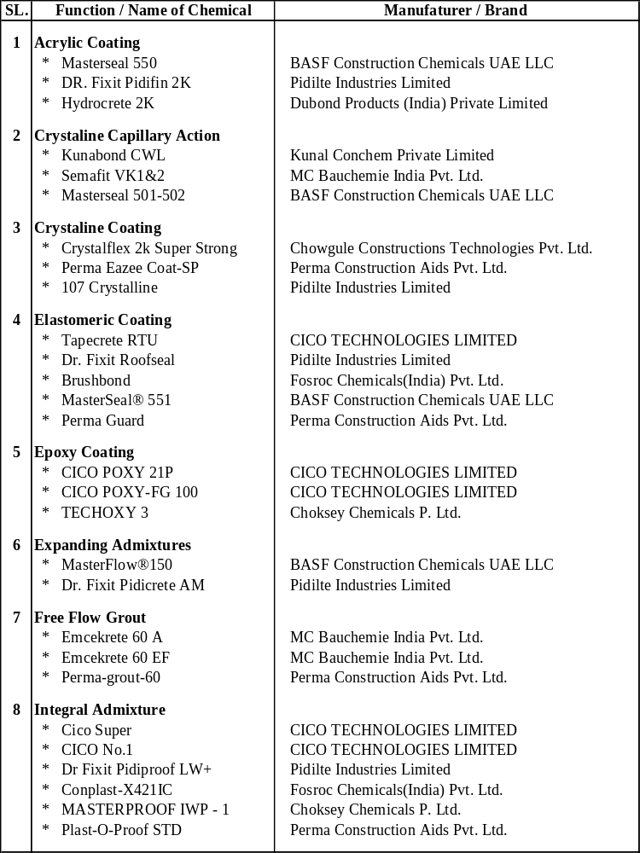
List of Chemical / Basic Material Proposed to Be Used
Co. Profile Contd.

Slide 10
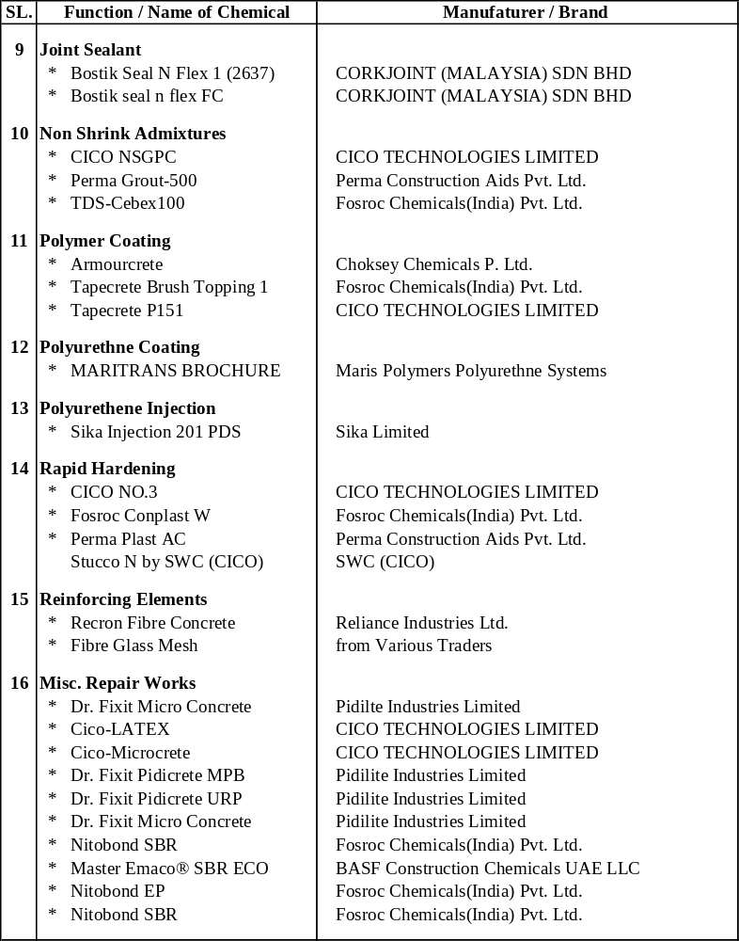
Contd. List of Chemicals / Materials
Co. Profile Contd.

Slide 11
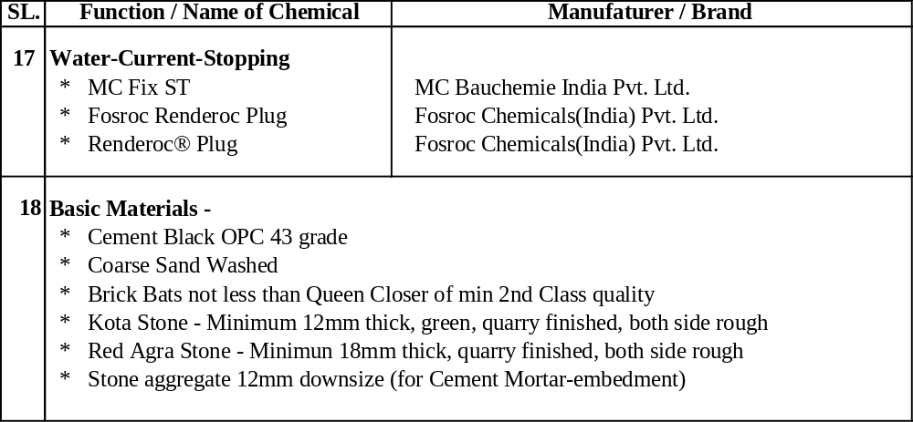
Contd. List of Chemicals / Materials
Contd. Jobs under SSWPS
Co. Profile Contd.

Slide 12
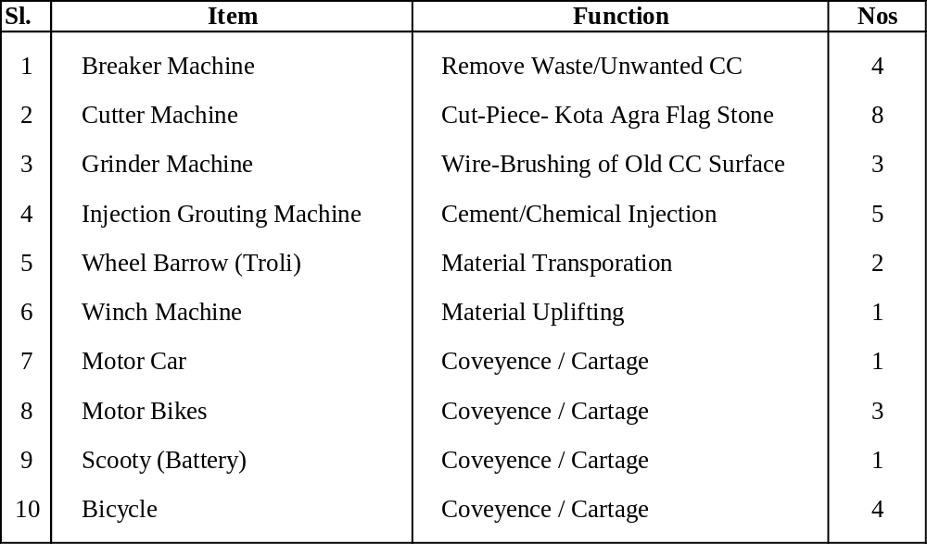
List of T&P & Conveyences
Co. Profile Contd.

Slide 13
Prospective Key Clients Since Mr. Shiv Kumar Verma Been Self Employed Since 1996 in The Exclusive Field of Waterproofing
* 3C Group of Company, Building No.-6, Sec-127, Expressway, Noida, U.P.-201301.
** 7-Nos of Mega Residential Complex of Approx 1400 Flats Basement to Machine Room
* Lotus Greens, Building No.-8, Sec-127, Expressway, Noida, U.P.-201301.
** 5-Nos of Mega Residential Complex of Approx 1400 Flats Basement to Machine Room
* G.S.Developers & Contractors Pvt. Ltd. 201-202, Shahpuri Tirath Singh Tower, C-58,
Community Centre, Janakpuri, New Delhi-110058.
** 60-Nos Jobs of Industrial, Commercial, Hotels, Residential & Institutional
* Ahuja Builders & M/s Ahuja Kashyap P. Ltd. at X-3, Hauzkhas, New Delhi-110016; Further
Shifted to -A-58, Sec-8, Noida, U.P.-201301.
** 55-Nos Jobs of Industrial, Commercial, Residential, Hotels & Institutional.
* Shrey Associates, S-33/34 JDA Shopping Centre, Amrapali Circle, Vaishali Nagar, Jaipur,
Rajasthan-302021.
** 15-Nos Jobs of Single Houses, Industrial, Commercial, Residential & Institutional
* Ambica Steel Limited, C-54/1, Wazirpur Industrial Area, Ring Road, New Delhi-110052.
** 14-Years Regularly in Projects & Extensions and Alteration of 8 Ind. & Res. Premises in NCR.
* United Builders, B 24, IInd Floor, Community Centre, B-1, Janakpuri, Delhi-110058.
** 11-Projects of Mega Housing Society Complexes, Institutional & Industrial Projects.
* Acme Construction Private Limited, 147, Kilokri, Opp. Maharani Bagh, New Delhi-110014.
** Since 1998 todate Consistantly Since Single Resi Houses Commercial, Institutional &
Resorts.
* Rakes Brothers, 207, Talmart-II, Jaina Tower-2, District Center, Janakpuri, New Delhi-110058.
** Since 2004 todate Industrial, Commercial, Residencial & Institutional Approx. 17 Projects.
* L. R. Sharma & Co., Unit-V-17, Green Park Extention, New Delhi-110016.
** DMRC Station Projects at Kalindi Kunj, Okhla, Janakpuri West, Dabri Mor, Delhi/NCR.
Co. Profile Contd.

Slide 14
Contd. List of Works under Shiv Kumar Verma Overall Since 1996
* Mirza International Limited, Corporate & Marketing Office, A-7, Mohan Cooperative
Industrial Estate, Mathura Road, New Delhi – 110076..
** 6-Projects in Commercial, Warehousing, Official, Resorts & Residencial.
* RRAJ Constructions P. Ltd., Unit No.-9293, G F, Vasant Kunj, New Delhi-110070.
** Since 2005 todate Consistantly Since Single Resi Houses to 11-Projects of Factories & Slater
Houses.
* Purvanchal Construction Works Private Limited, 159/C, 3rd Floor, Sarai Jullena, Okhla,
New Delhi-110025.
** 2-Residencial Complexes of 7-Floors i.e. Silver Estate, Sec-50 & Silvercity-I, Sec-93, Noida.
* Samiah International Builders Pvt. Ltd., A-35 Samiah House, Sector-63, Noida, Uttar
Pradesh-201301.
** 1-Residencial Complex-M Media Village, 1-Hostel Building of IIT-Hauzkhas, 1-Admn
Building of Tehri Hydro Power Development Corporation.
* Mahender Jain & Co., D-1/A, Green Park Main, New Delhi-110016.
** 26-Nos 4-Storeyed Residencial Houses Basement to Mumty in South Delhi Areas.
* Lotus Education Group, Plot No.-2, Sec-126, Expressway, Noida, U.P.-201301.
** 3-International School Project & Extention & Alteration in Noida & Gurgaon Since 2002.
* CPWD Projects on Sub-contract in Sub-division Nazafgarh of Division Rohini.
** 6-Nos Fresh & Alteration Projects Since 2004 to 2008
* Govt. Under-taking, Local Authorities & Institutions Projects on Sub-contracts.
** 24-Nos Jobs at Airport Authority Palam & Alihgarh, Bank of India, Bank of Baroda, China
Ambassy, CRPF Traing School, Police Training School, DMRC-Tagore Garden / Subhash
Nagar/Tilak Nagar, Kalindi Kunj/ Okhla/Dabari Mor/Janakpuri, Gurukul Kangri Univercity,
IIT-Hostel, MCD RUB-Britania, NBCC, NCUI, NSIT, NPCC, RBI-Lucknow, Standard
Chartered Bank, Russian Culture Centre, USA-Education Foundation, UP Bridge
Corporation.
Co. Profile Contd.

Slide 15
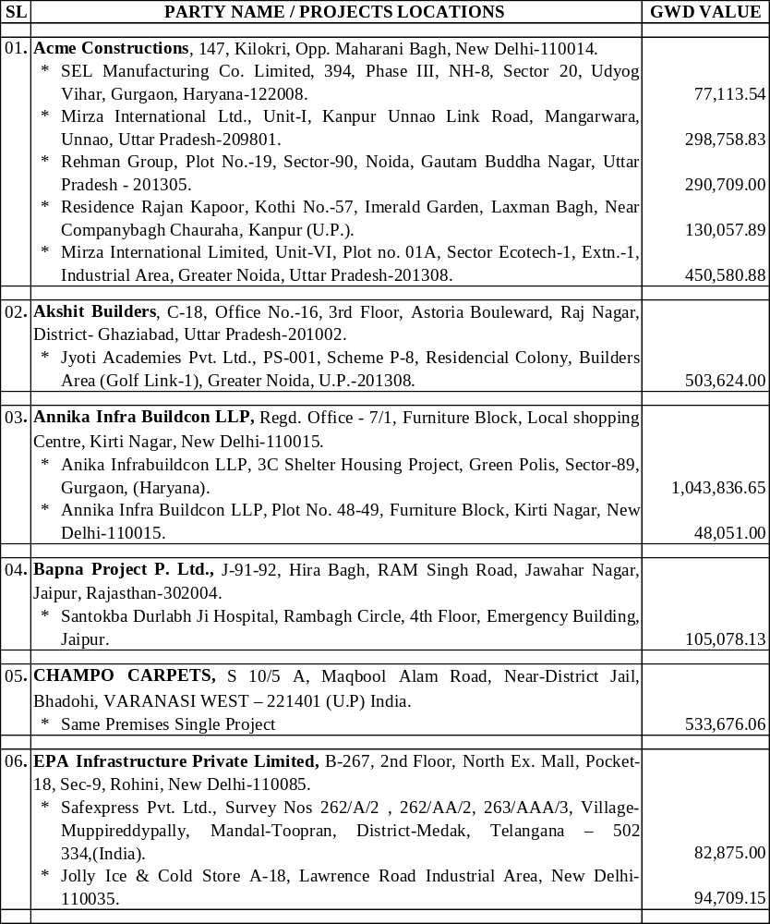
List of Works in Present SSWPS Concern since 08.05. 2015-31.05.2018
Co. Profile Contd.

Slide 16
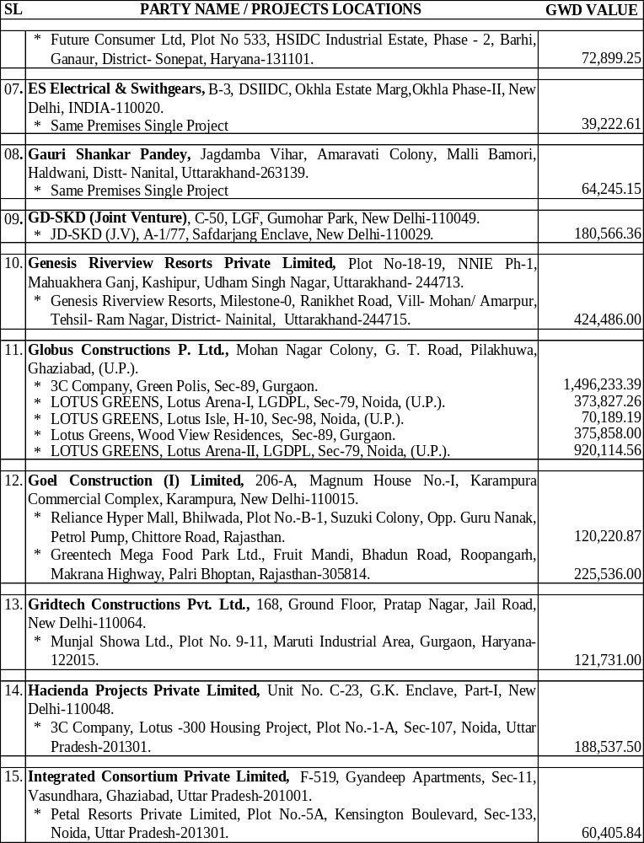
Contd. Jobs under SSWPS
Co. Profile Contd.
Contd...

Slide 17
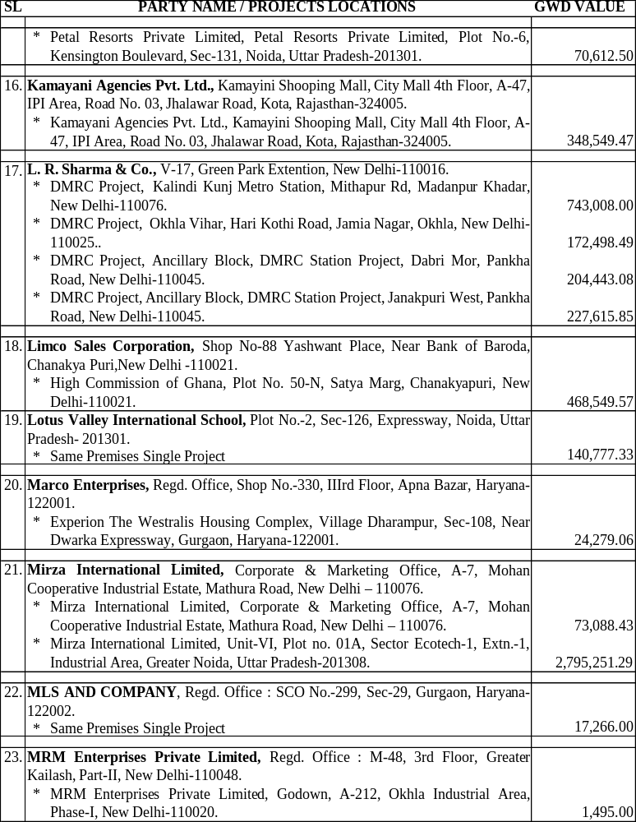
Contd. Jobs under SSWPS
Co. Profile Contd.
Contd...

Slide 18
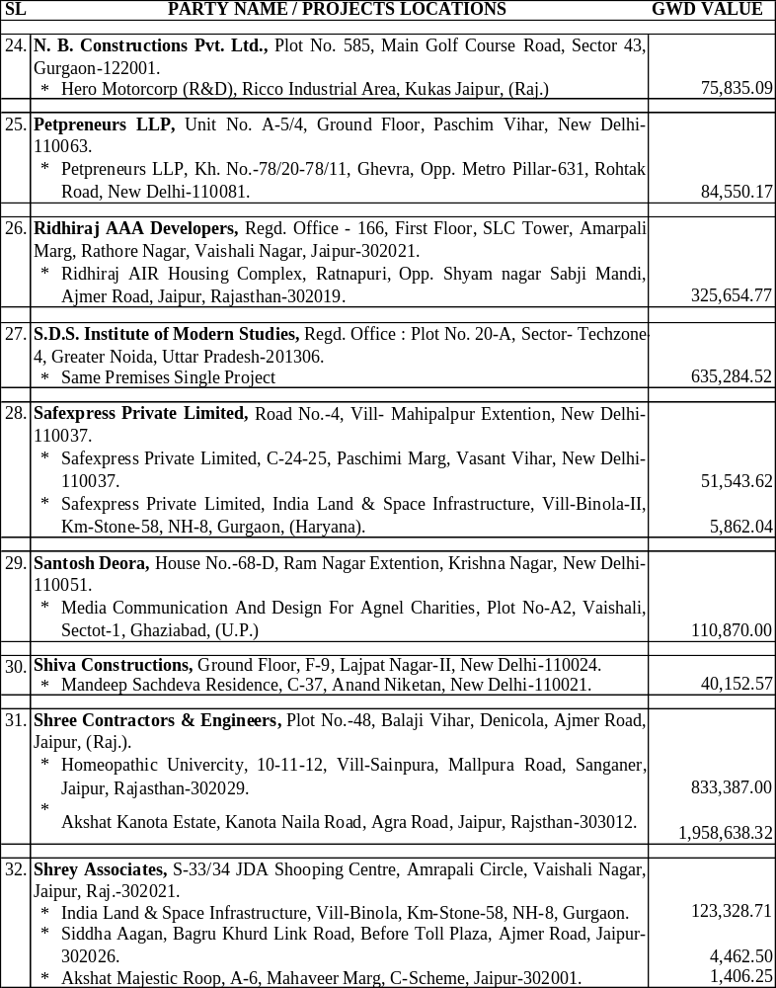
Contd. Jobs under SSWPS
Contd.
Co. Profile Contd.

Slide 19
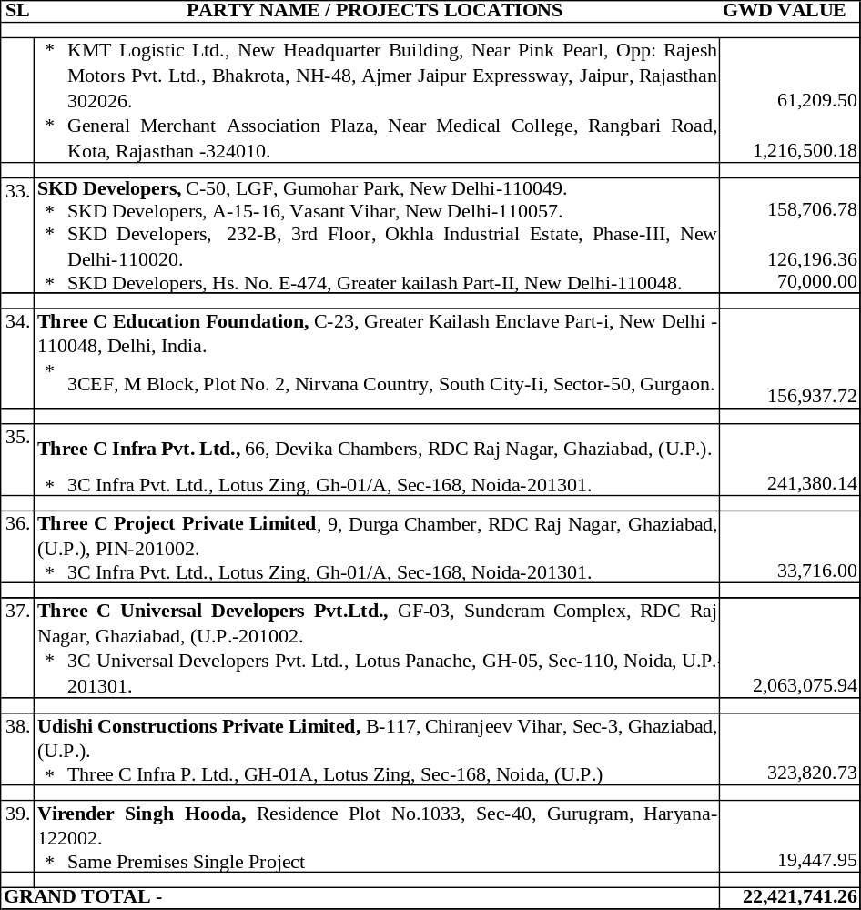
Contd. Jobs under SSWPS
Co. Profile Contd.

Slide 20
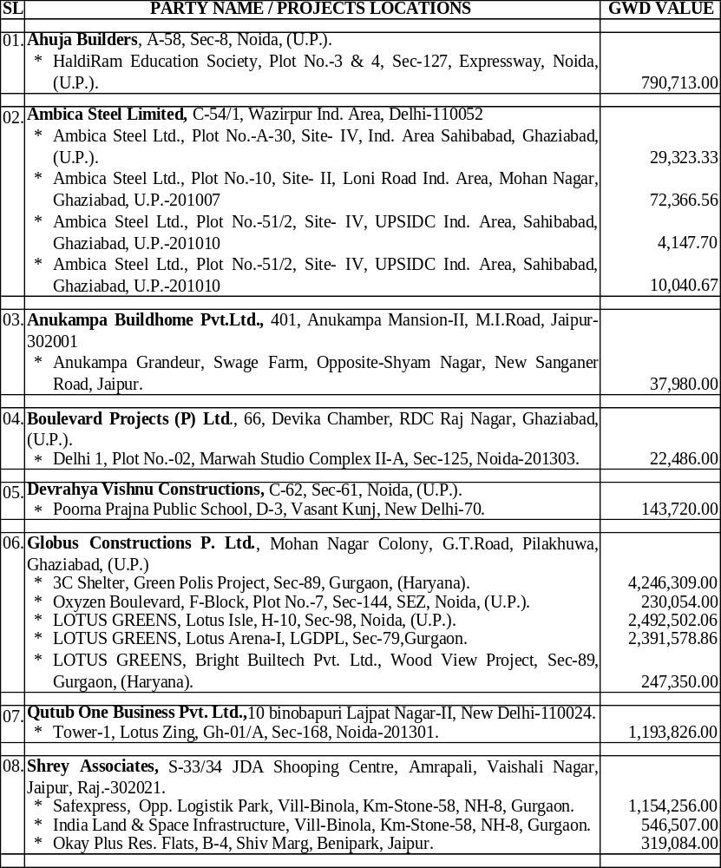
List Of Works Executed while the Same owner Running in The Name of “Satyam Shivam Waterseal Private Limited” Since 04.08.2013 to 31.07.2015
Co. Profile Contd.

Slide 21
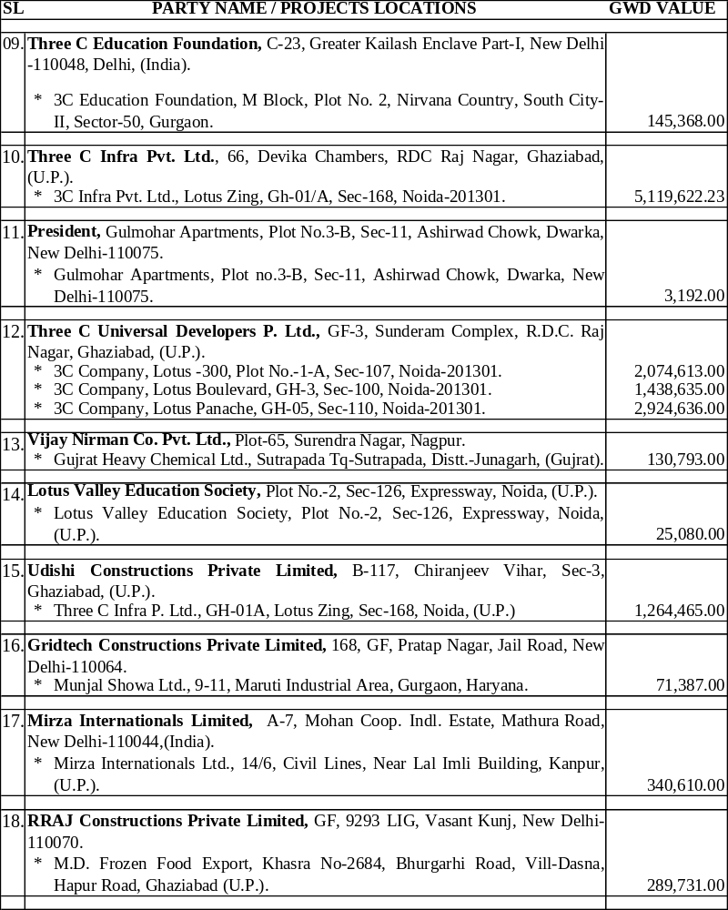
Contd. Jobs under SSWPL
Co. Profile Contd.

Slide 22
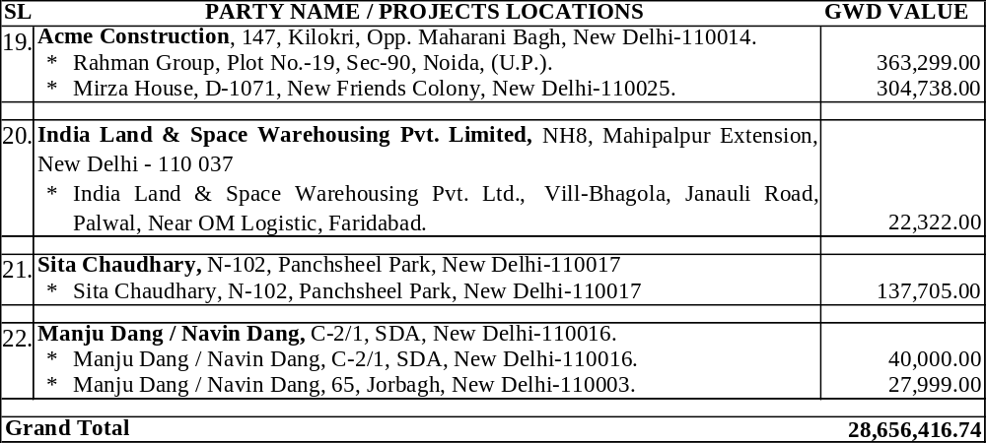
Contd. Jobs under SSWPL
Co. Profile Contd.

Slide 23
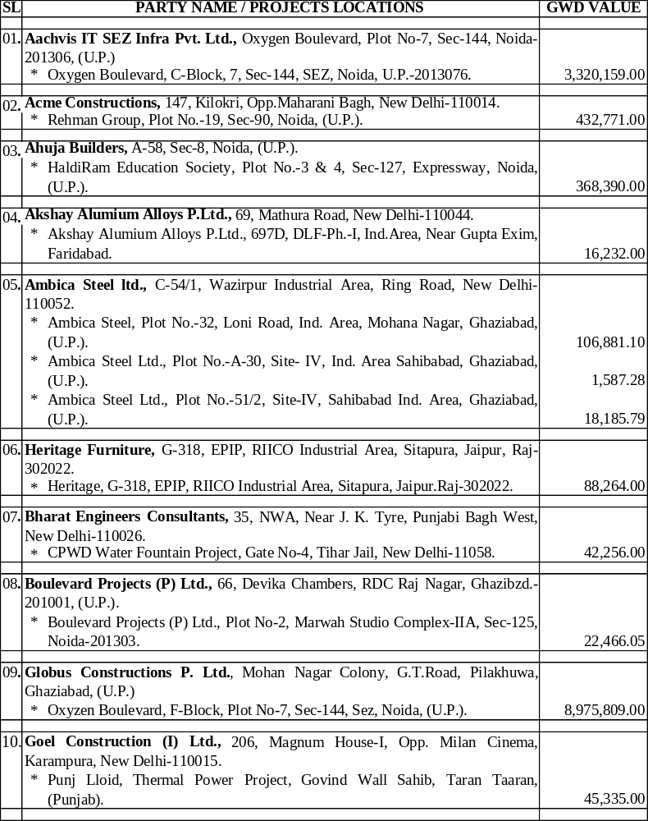
Works Executed while the Same owner Running in The Name of “SS Seepage Solutions Private Limited” Since 29.03.2012 to 30.09.2013
Co. Profile Contd.
Contd.

Slide 24
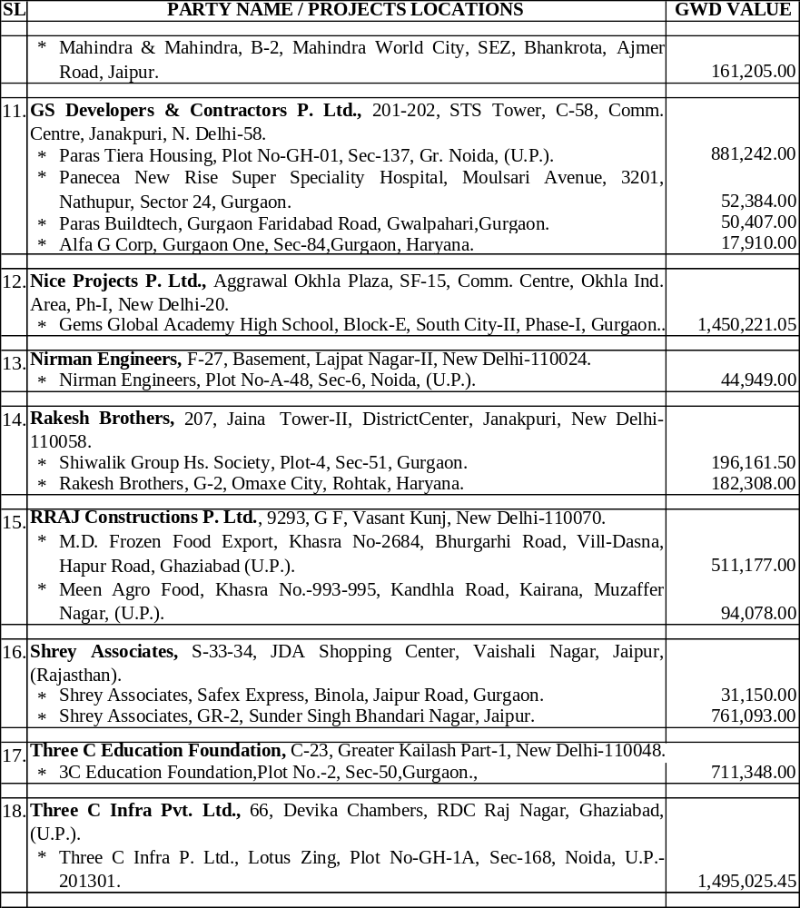
Contd. SSSSPL Jobs
Co. Profile Contd.

Slide 25
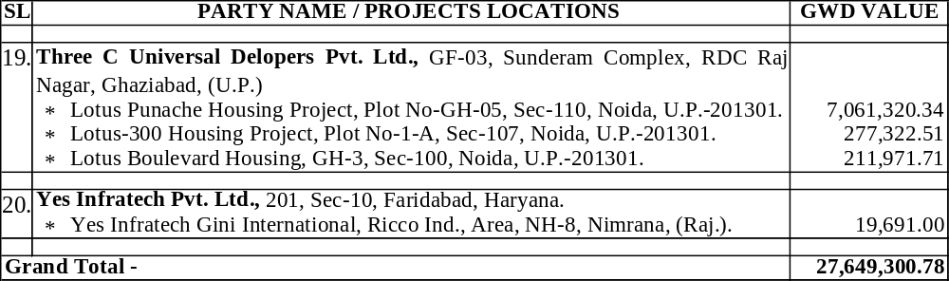
Contd. SSSSPL Jobs
Co. Profile Contd.

Slide 26
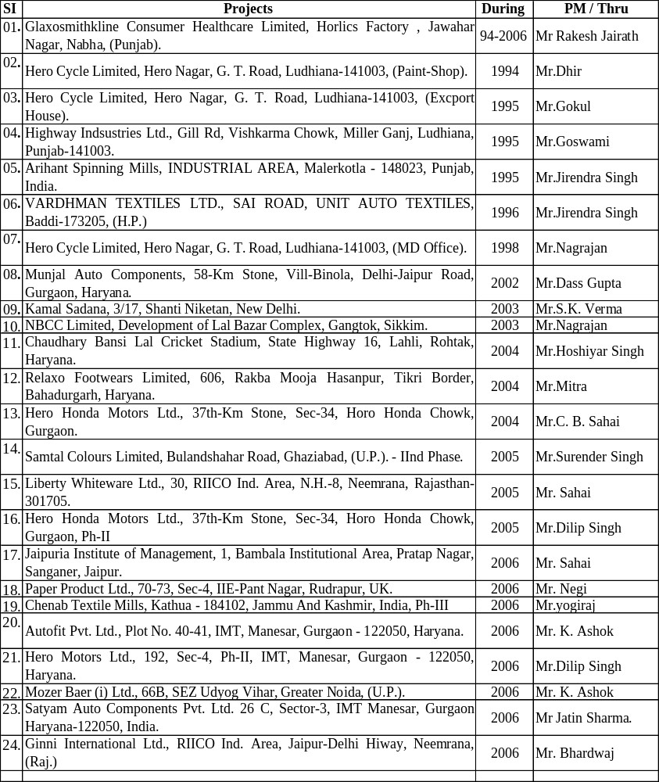
Works Executed for M/s Ahuja Builders, A-58, Sec-8, Noida by Same Owner in the Name of “Consistant Waterproofing Co.” Since 1996 to 2012
Co. Profile Contd.

Slide 27
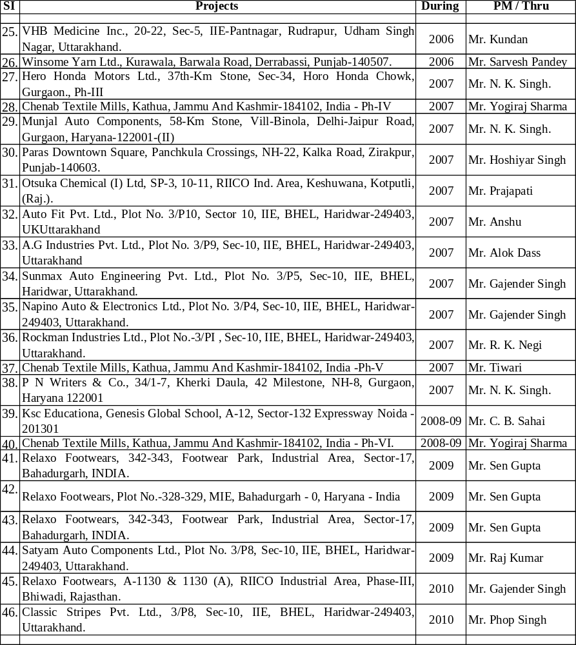
Contd. CWC Jobs for m/s Ahuja Builders
Co. Profile Contd.

Slide 28
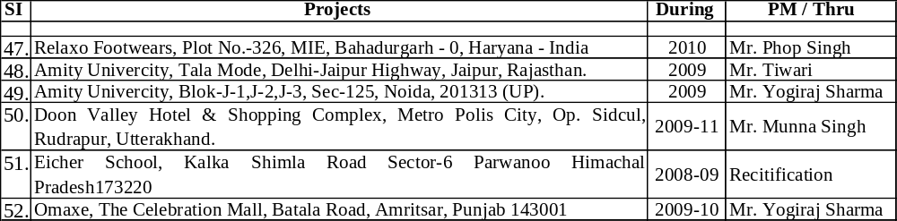
Contd. CWC Jobs for m/s Ahuja Builders
Contd. CWC Jobs
Co. Profile Contd.

Slide 29
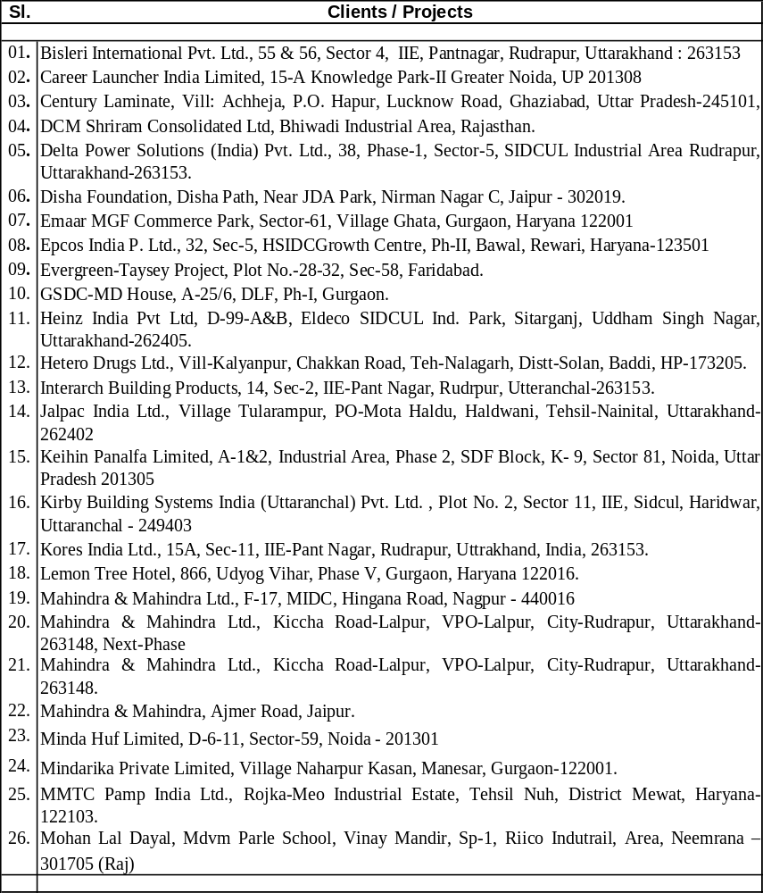
Jobs M/s “GS Developers & Contractors P. Ltd.” 201-202, STS Tower, C-58, Comm. Centre, Janakpuri, N. Delhi-58 Vs “Consistant Waterproofing Co.” Since 1996 to 2012
Co. Profile Contd.

Slide 30
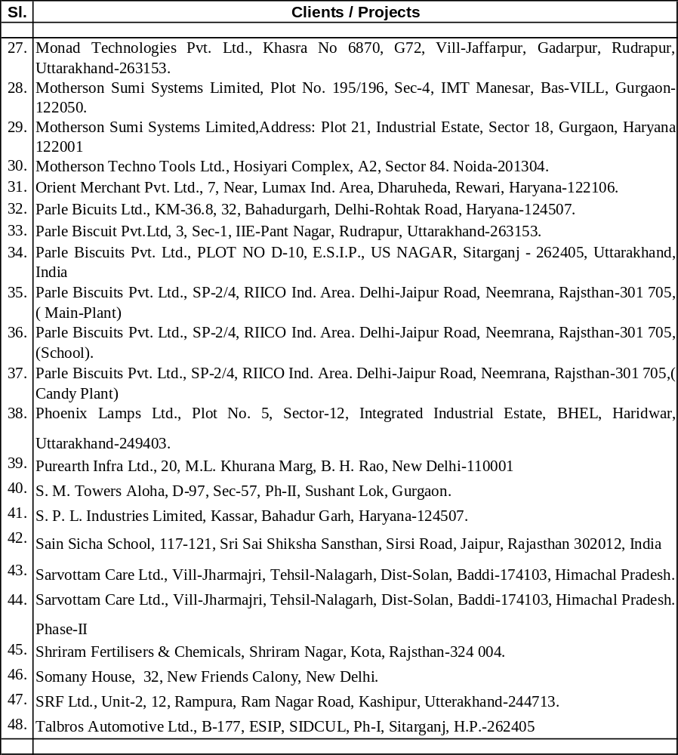
Contd. CWC Jobs for m/s G.S. Developers & Contractors Pvt. Ltd.
Contd. CWC Jobs
Co. Profile Contd.

Slide 31
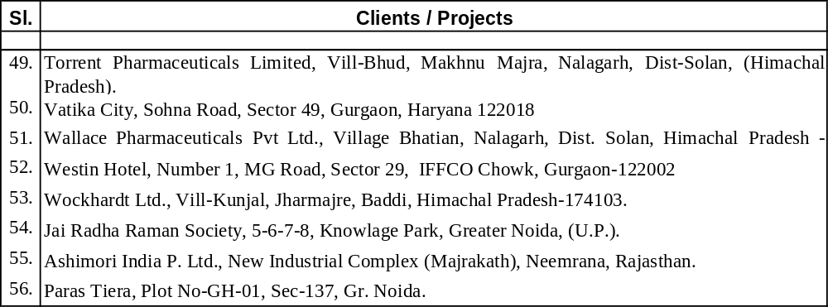
Contd. CWC Jobs for m/s G.S. Developers & Contractors Pvt. Ltd.
Contd. CWC Jobs
Co. Profile Contd.

Slide 32
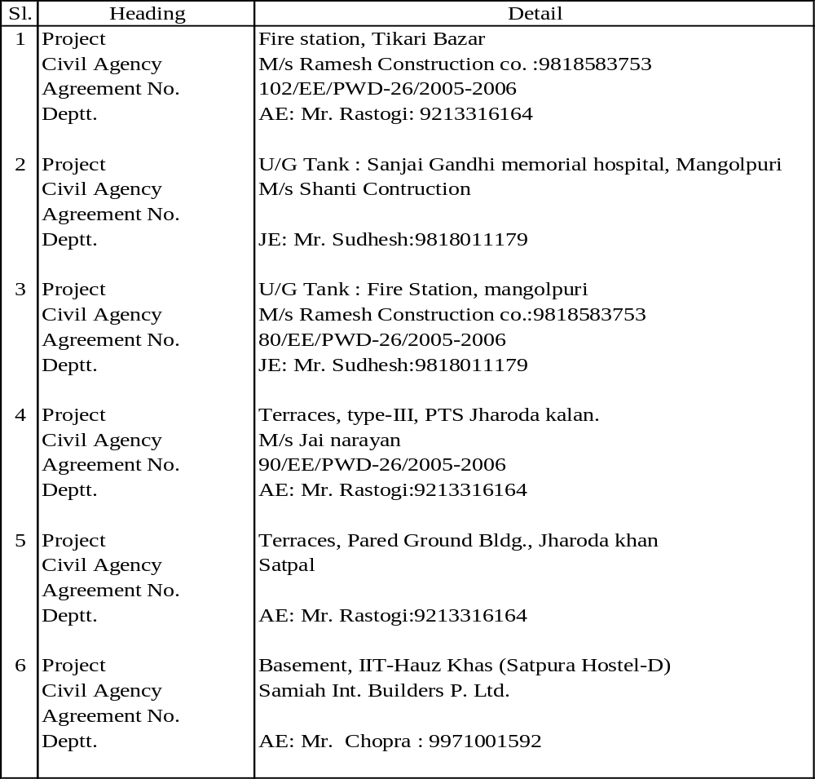
Jobs with Prime Contractors for “Central Public Works Department” Vs “Consistant Waterproofing Co.” Since 2004 to 2008
Co. Profile Contd.
Co. Profile Cond.

Slide 33
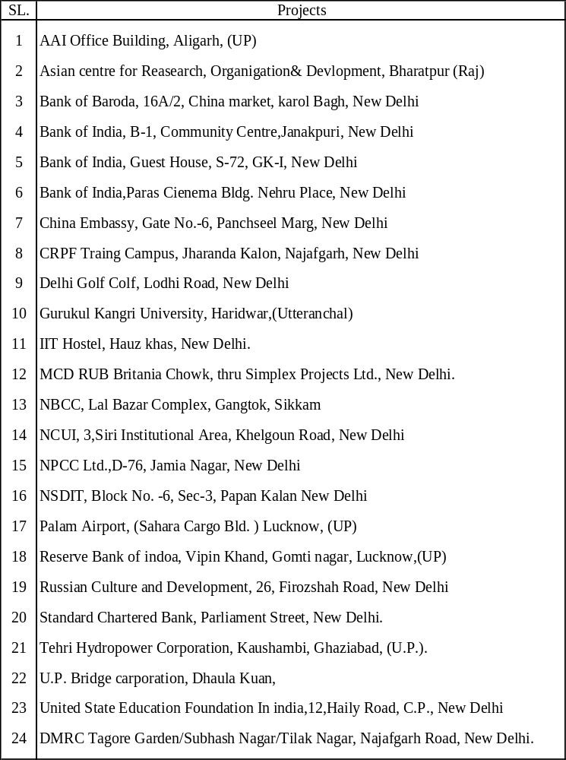
Jobs with Prime Contractors and Directly also for “Semi Govt. Departments & Institurions” Vs “Consistant Waterproofing Co.” Since 2004 to 2008
Co. Profile Cond.

Slide 34
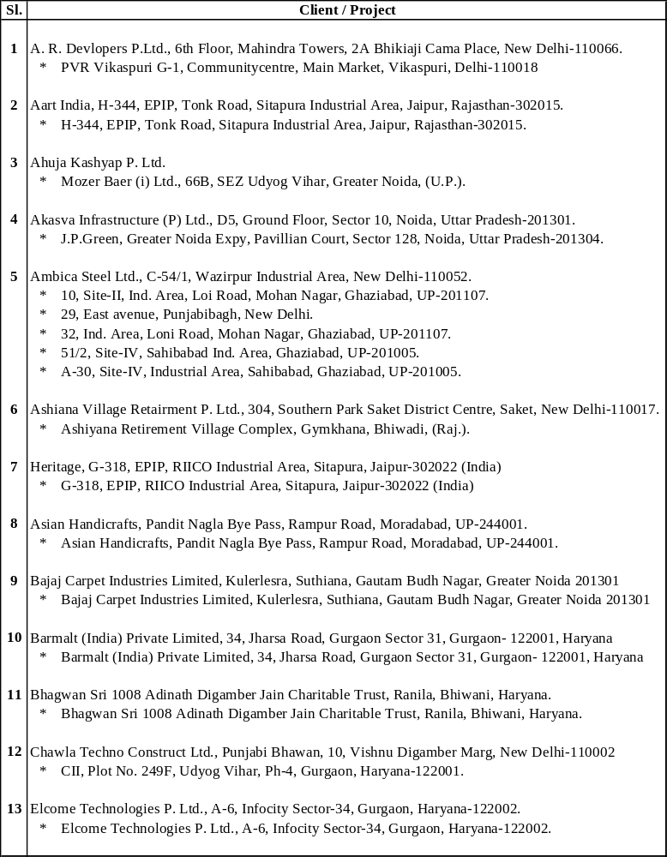
Jobs with other Misc. Clients / Prime Contractors Vs “Consistant Waterproofing Co.” Since 1996 to 2015
Co. Profile Cond.

Slide 35
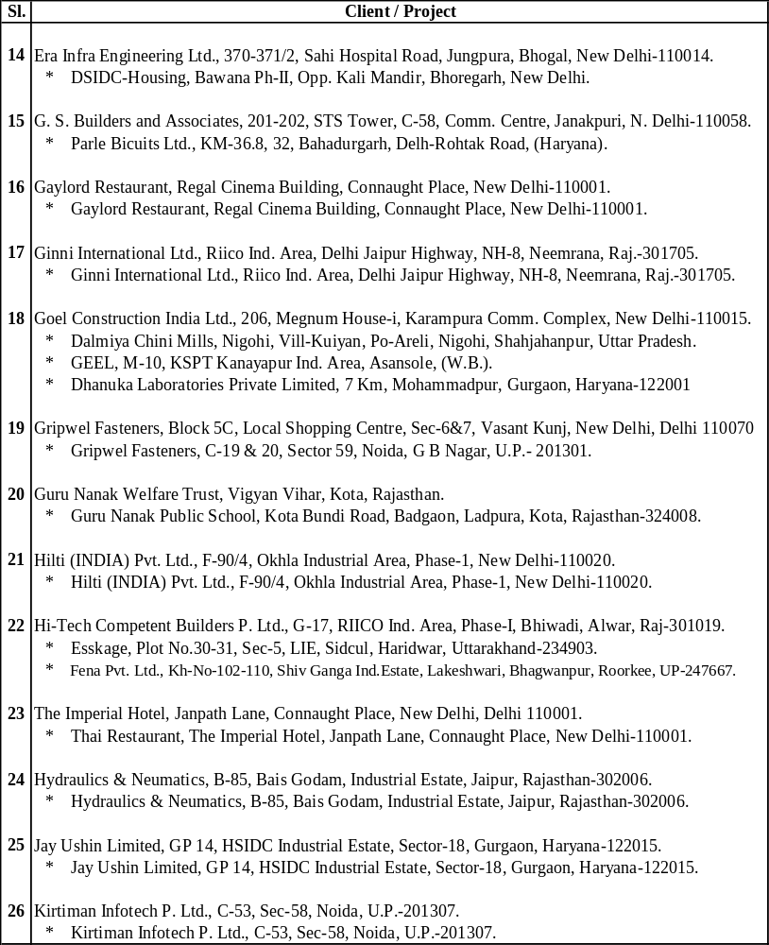
Contd Misc. Clints in CWC
Co. Profile Cond.

Slide 36
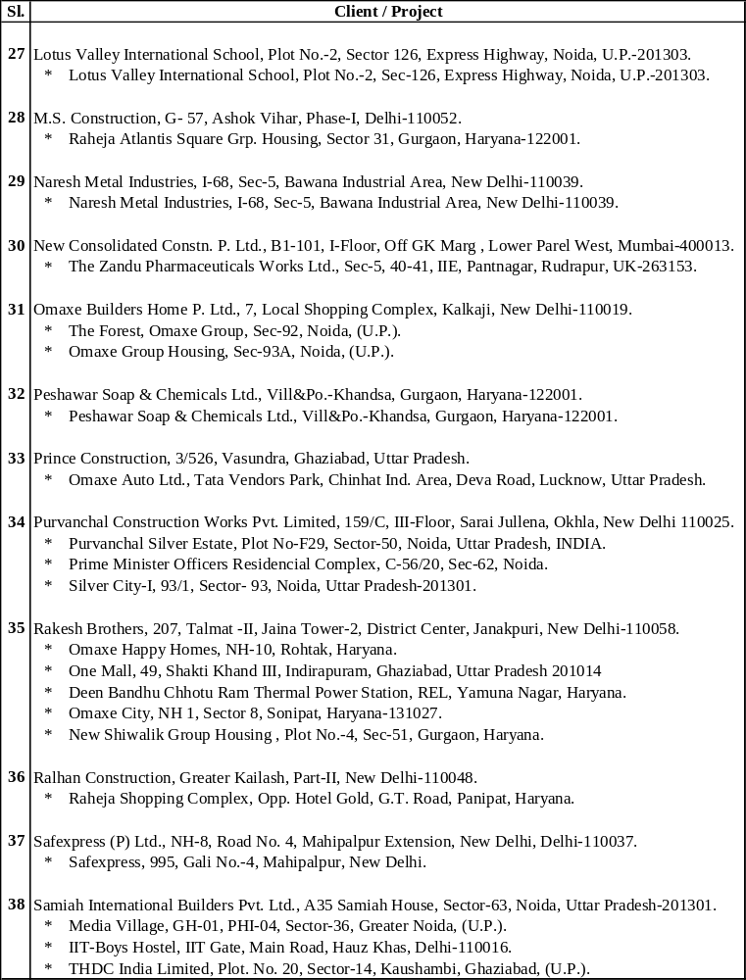
Contd Misc. Clints in CWC
Co. Profile Cond.

Slide 37
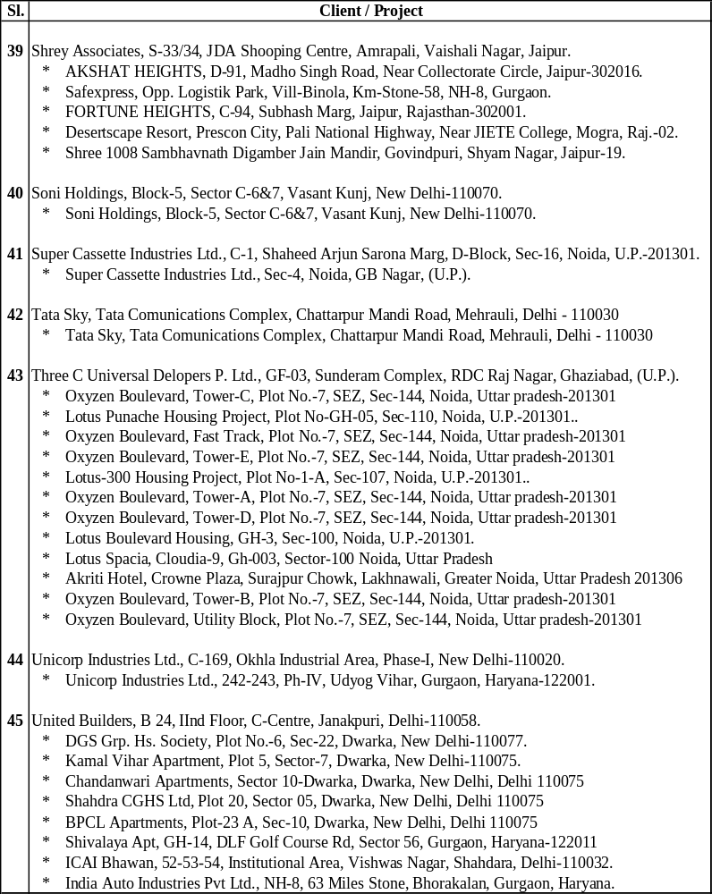
Contd Misc. Clints in CWC
Co. Profile Cond.

Slide 38
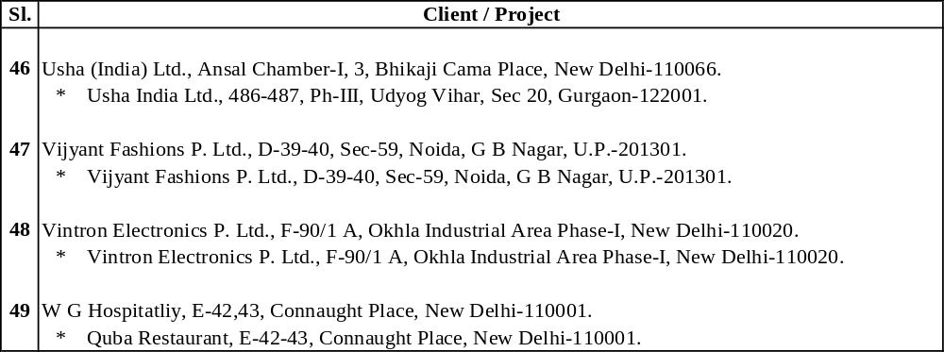
Contd Misc. Clints in CWC
- : THE END : -

